Slide 1
Project Management Tools
Connor Stewart, Fraser stalker, Louis Smith

Slide 2
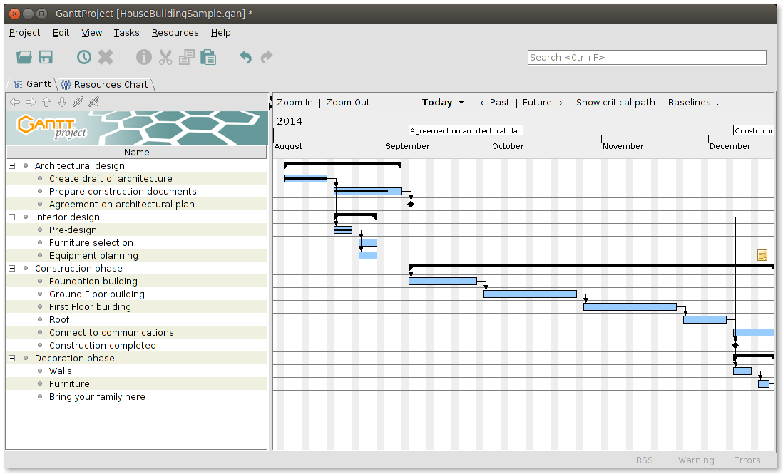
GanntProject
Pros
Cons
Easy to use.
Simple Interface
Runs on Windows, Linux and Mac.
Free!
No reoccurring tasks.
No integration with other tools.
May be too simplistic for your needs.
Notes:
Something everyone has seen in our practical classes.
Basic Tool
Does what you need at a basic level.
Easy to use due to a simple interface.
Runs on all major operating systems.
Free!
No re-occurring tasks,
Little integration with other tools.
References:
https://www.macworld.co.uk/download/office-business/ganttproject-289-3328394/

Slide 3
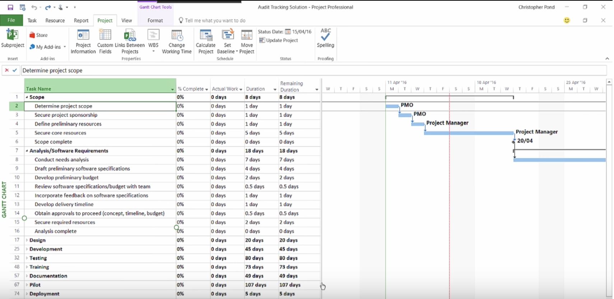
Microsoft Project
Pros
Cons
Many features.
Integrates with other Microsoft products such as Skype and SharePoint.
Similar interface to other Microsoft products.
Wide usage in the industry.
High learning curve.
Only runs on windows.
Costly to purchase.
Notes:
Many features.
Can be confusing.
Some features may go unused.
Familiar Microsoft interface; Word, Excel and PowerPoint.
Widely used in the industry so they’ll be a lot of documentation online.
High learning curve, not suitable for beginners.
Only runs on windows.
Costly to purchase.
References:
https://www.softwareadvice.com/resources/microsoft-project-pros-and-cons-for-smbs/

Slide 4
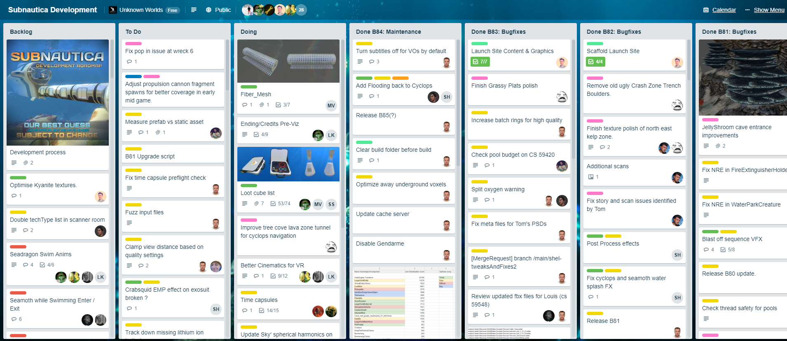
Trello Board
Pros
Cons
Easy to use.
Simple Interface
Runs in the cloud.
Free, with premium subscription.
Integration with multiple tools such as Slack, Google Drive and JIRA.
No default Gannt/PERT chart functionality.
Cannot split time on tasks or “cards”.
Notes:
A Trello board is not your typical project management tool but I thought it would be worth mentioning.
Pictured left is the public Trello board for the game “Subnautica”, they use their Trello board to split their tasks into categories and add team members to certain tasks.
Runs in the cloud so its easy to integrate with current systems.
Integration with multiple other tools.
No default Gannt/PERT chart but this is not so much of a con as I don’t see this as a Trello Boards main functionality., can be added via an extension though.
Cannot set members effort on tasks on cards, again this is fine due to the reason stated above.

Slide 5
Case Study 1
Payroll Processing at Brightmouth College
Not directly creating a new system.
Purchasing a prebuilt/”off-the-shelf” system.
Has no need for a complicated package.
Simply needs to manage installing and training staff to use the “off-the-shelf” package.
Brightmouth College is a higher education institution which used to be managed by a local government authority but has now become autonomous. Its payroll is still administered by the local authority and pay slips and other output are produced in the local authority’s computer centre. The authority now charges the college for this service. The college management are of the opinion that it would be cheaper to obtain an “off-the-shelf” payroll package and do the payroll processing themselves. Brightmouth College have recently hired a new Information Systems Development Officer, who has been asked to manage the independent payroll processing project.
Notes:
GanntProject is the best choice for this project as something as complex as Microsoft Project is not needed since the only major task this manager will need to cope with is simply using the new software.
Microsoft Project is simply overkill for this task.
Trello Board is no use since there is no actual development going on.

Slide 6
Case Study 2
International Office Equipment Group Maintenance Accounts
Extending the existing system.
Developing new features, unlike previous case study.
Will need to manage entire development cycle.
International Office Equipment (IOE) is a company which manufactures and supplies various items of high-technology office equipment. An expanding area of their work is the maintenance of ICT equipment. They have now started to undertake maintenance of equipment for which they were not originally the suppliers. A computer-based batch processing system deals with invoicing on a job-by-job basis. An organization might have to call IOE out several times to deal with different bits of equipment and there is a need to be able to group the invoice details for work done into “group accounts” for which monthly statements will be produced. A new project manager has been given the task of implementing this extension to the invoicing system.
Notes:
For this I would recommend a combination of Microsoft Project and a Trello board.
GanntProject is too simple for this task as there might be things such as reoccurring tasks.
Since there is actually development going on a Trello Board would be useful to manage development.
Microsoft Project can be integrated with a Trello Board.

